Slide 1
NYPD Shooting Incident Data Analysis
Publisher: City of NY
https://catalog.data.gov/dataset
https://catalog.data.gov/dataset?publisher=data.cityofnewyork.us

Slide 2

Summary
A Deep Dive into the Shooting Incidents reported from the year 2006-Present in New York City. The data stores details of victim, perpetrator, location of incident and if this was a Murder or a non-Murder realted shooting incident.

Slide 3
Bias and Assumptions
More Shootings after Dark
Don’t go into Certain Neighbourhoods?
We are more likely to encounter shooting after dark. Weekends should also result in more reported shootings than weekdays.
Shootings have gone up in last few years?

Slide 4
Data Cleanup
Column Reorganize
Handling Nulls/ Blanks
Active Investigation
Data Anomaly

Slide 5
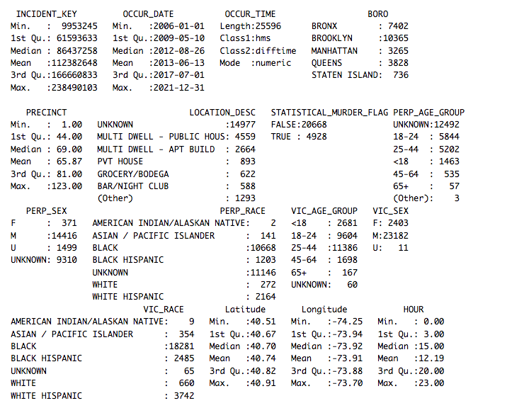
Conflict
20% of all Incidents are Murders
Majority of Victims and Perpetrators were Men
Black People were the largest affected demographic of Gun Violence
Residential far more frequent than Commercial (among known locations)

Slide 6
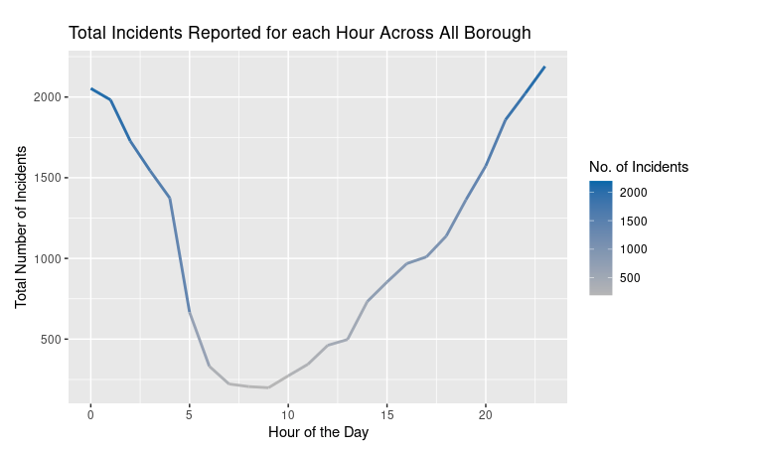
How many Shootings during various Hours of the day ?

Slide 7
Do NYC Neighbourhoods follow this trend?

Slide 8
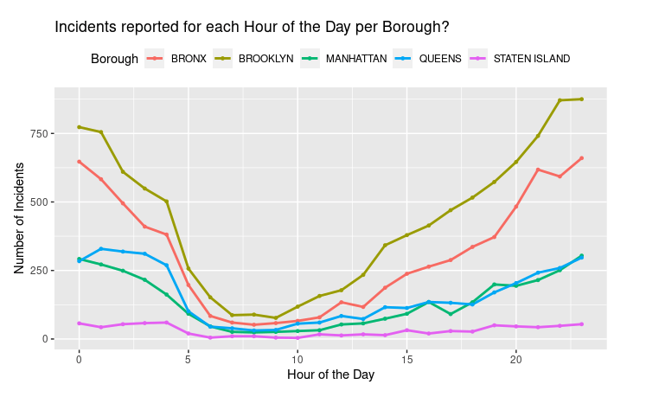
Borough, Brooklyn,Bronx and Queens register the highest number of incidents reported for each hour, closely followed by Manhattan.
All the Boroughs follow a citywide pattern of crime increasing after work hours and decreasing during the day

Slide 9
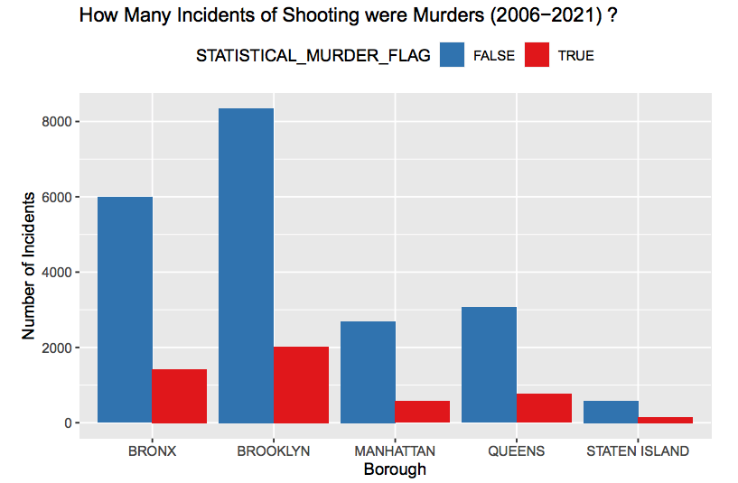
20%
Of Reported shootings are Murders across all Boroughs, consistent with Citywide trend.
Most Populated Neighbourhoods see the most shootings.
Both Murder and Non-Murder Shootings highest in Brooklyn

Slide 10
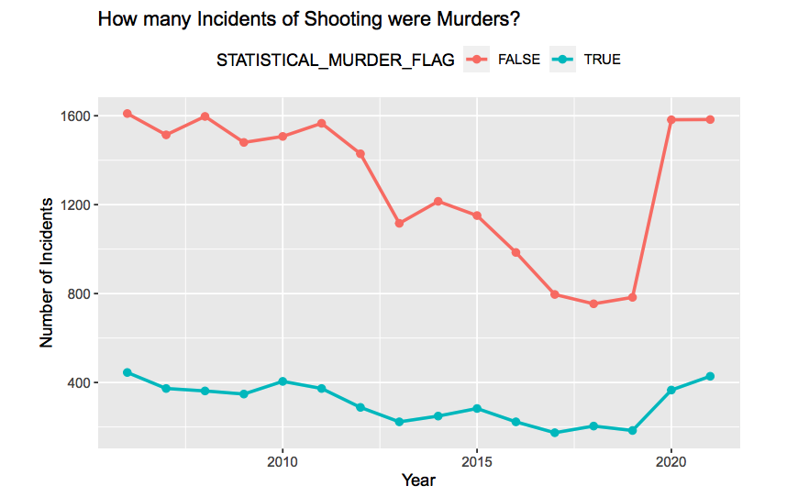
About 20% of total Shooting reported are Murders
Shootings have declined by 5% per year average since 2006 till 2020

Slide 11
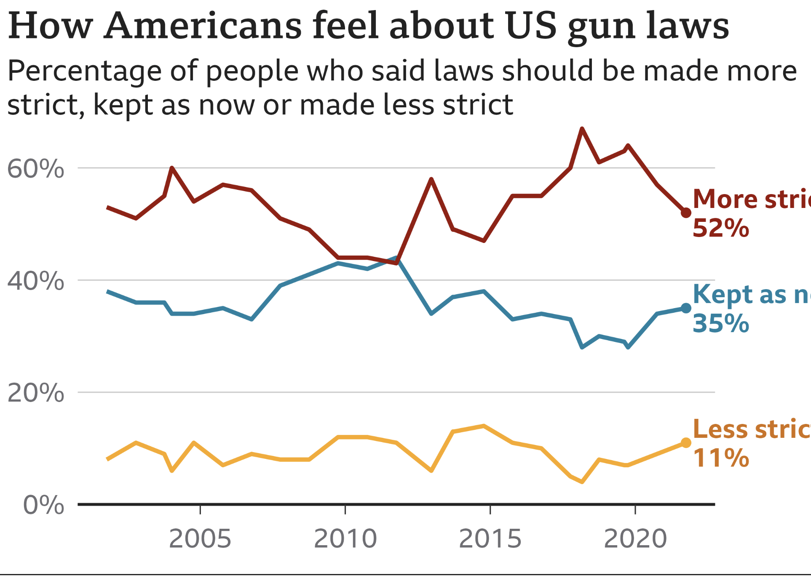
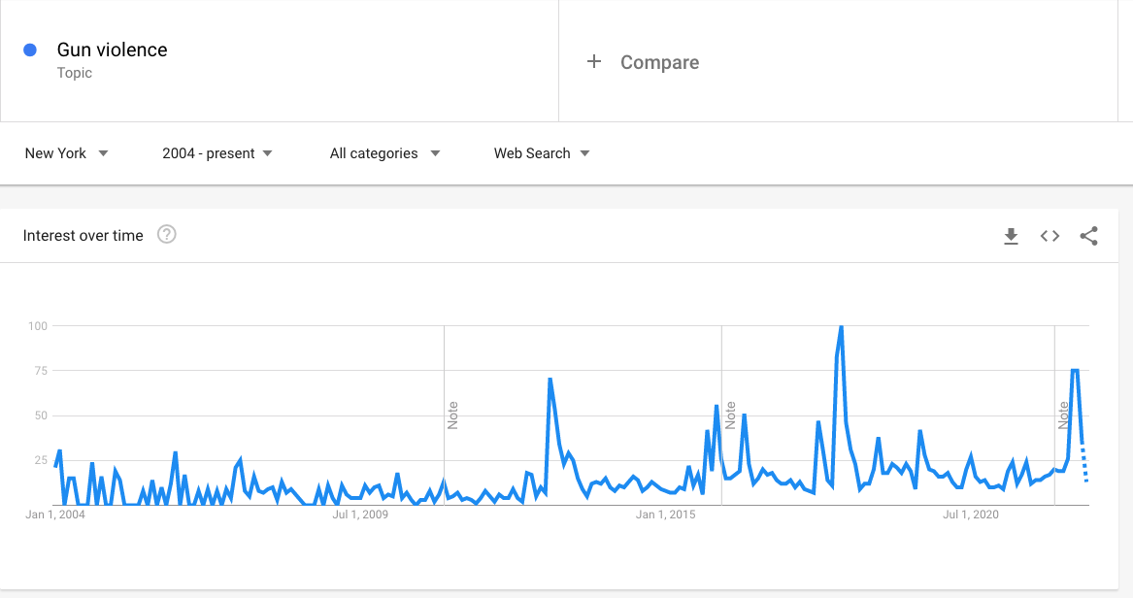
Conversations and Polling about Gun Violence/laws
Source: Gallup poll October 2021
Source: Google Search Trends for New York

Slide 12
Are There More Shootings on the Weekends?

Slide 13
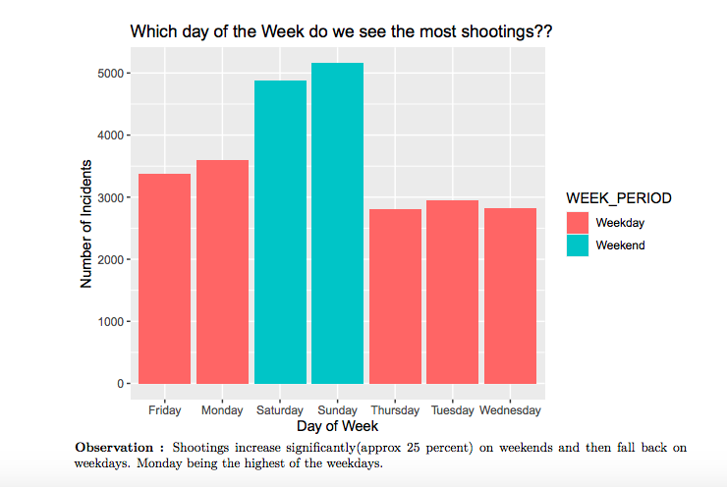

Slide 14
Model
Is there a correlation between murder and time of the day?
Are there more reported murders for a particular time of the day?

Slide 15
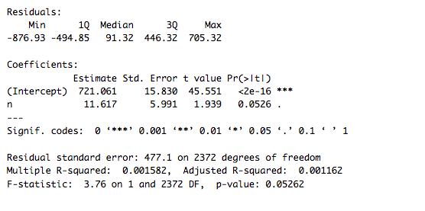
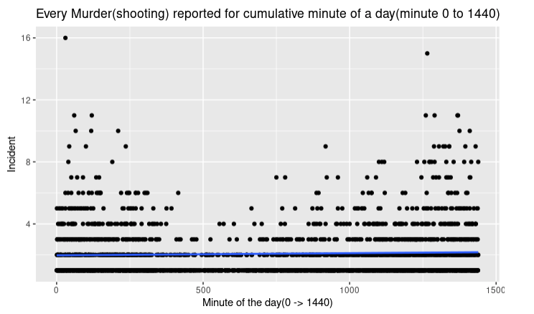
Regression Model
P-value > 0.5
Null Hypothesis Rejected. We Cannot find a correlation between time of the day and increase in crime.

Slide 16
Can we Explain the Reasons for why the correlation fails?
Model is dependent of factors such as day of the week, time of the year, neighbourhood and socio-political factors such as pandemic, social climate of the region etc and just time of the day is not significant for predicting crime.

Slide 17
Conclusion
Did the data match our intuition?
Predicting crime is complicated and needs a variety of fields such as data science, Statistics, sociology, psychology, Urbanization, humanities, and many other to come together.
We should be very careful about data related to Race
Context is very important.

